Slide 1



Exploratory Data Analysis
Final Term Project
DSC530
Sharath Chandra Tummanapally
Nov 18, 2021

Slide 2


Research topic:
Is it possible for a company to develop its business by researching the personality of its ideal customers?

Slide 3
Merge at least two datasets. Consider a minimum of 5 numeric variables in your dataset. What variables you think could have an impact on your question?
Dataset 1: cust_prof_df
Dataset 2: cust_mkt_df
Both merged to form ‘cust_df’
NumWebPurchases, NumStorePurchases, Income, Complain, NumWebVisitsMonth are the variables that have impact on my research question.
Describe what the 5 variables mean in the dataset (Chapter 1)
NumWebPurchases is the integer ID of the Customer number of purchases on internet.
NumStorePurchases is the integer ID of the Customer number of purchases in store.
Income is the integer ID of Customer's yearly household income. Complain is Boolean of 1 if customer complained in the last 2 years, 0 otherwise.
NumWebVisitsMonth is the integer ID of Number of visits to company’s web site in the last month.

Slide 4
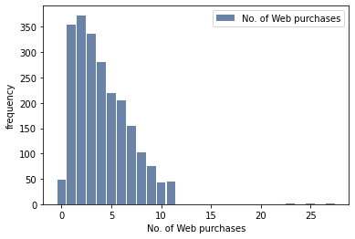
Include a histogram of each of the 5 variables
NumWebPurchases - No. of Web purchases

Slide 5
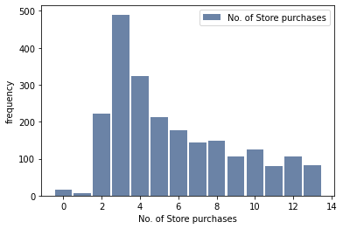
Include a histogram of each of the 5 variables
2. NumStorePurchases - No. of Store purchases

Slide 6
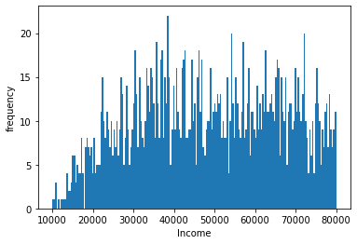
Include a histogram of each of the 5 variables
3. Income

Slide 7
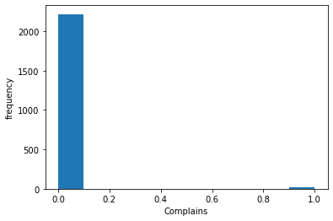
Include a histogram of each of the 5 variables
4. Complain

Slide 8
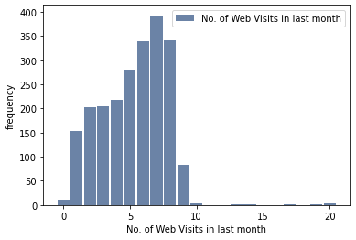
Include a histogram of each of the 5 variables
5. NumWebVisitsMonth - No. of Web visits in last month

Slide 9
Include the other descriptive characteristics about the variables: mean, mode, spread, and tails
No. of Web purchases mean is: 4.084821428571429
No. of Web purchases variance is: 7.7212523128948245
No. of Web purchases standard deviation is: 2.7787141473881087
No. of Store purchases mean is: 5.790178571428571
No. of Store purchases variance is: 10.568728864926845
No. of Store purchases standard deviation is: 3.250958145674417
Income mean is: 52247.25135379061
Income variance is: 633683788.5756192
Income standard deviation is: 25173.07666090141
Complain mean is: 0.009375
Complain variance is: 0.009291257257704457
Complain standard deviation is: 0.0963911679444982
No. of Web Visits in last Month mean is: 5.316517857142857
No. of Web Visits in last Month variance is: 5.888606002360743
No. of Web Visits in last Month standard deviation is: 2.426645009547285

Slide 10
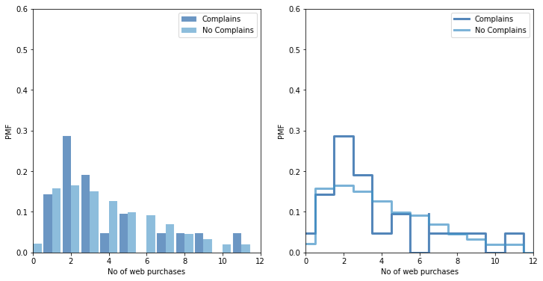
Using pg. 29 of your text as an example, compare two scenarios in your data using a PMF
Here by looking at the above PMF plot we can say that within the customers with less No. of Web purchases, the Complains are more compared to the customers with more No. of Web Purchases.

Slide 11
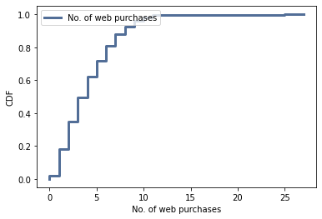
Create 1 CDF with one of your variables, using page 41-44 as your guide, what does this tell you about your variable and how does it address the question you are trying to answer
From the above CDF plot of No. of web purchases, we can see only 10% of the population makes no purchases below 1 and above 12. Most of the population make the no. of web purchases between 1 to 10.

Slide 12
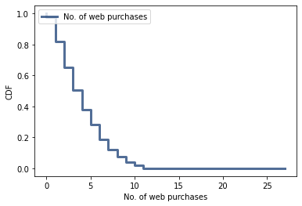
Plot 1 analytical distribution and provide your analysis on how it applies to the dataset you have chosen
From the above plot of complementary CDF on a log-y scale we can see it is not a perfect straight line. So, we can say the exponential distribution model is not a perfect fit for No. of web purchases.

Slide 13
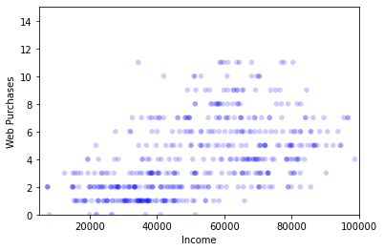
Create two scatter plots comparing two variables and provide your analysis on correlation and causation. Remember, covariance, pearson’s correlation, and non-linear relationships should also be considered during your analysis
Covariance: 0.012560000000000002
Correlation: 0.0399892725226043
From the correlation and covariance value we can see there is a positive correlation between Income of the customer and the Number of Web purchases. The more the income of the customer, the more they tend to purchase on web and vice versa.
And from the correlation test, we got p-value < 0.05 most of the times. So, we can say that Income's impact on Number of web purchases is statistically significant.
Scatterplot comparing NumWebPurchases, Income

Slide 14
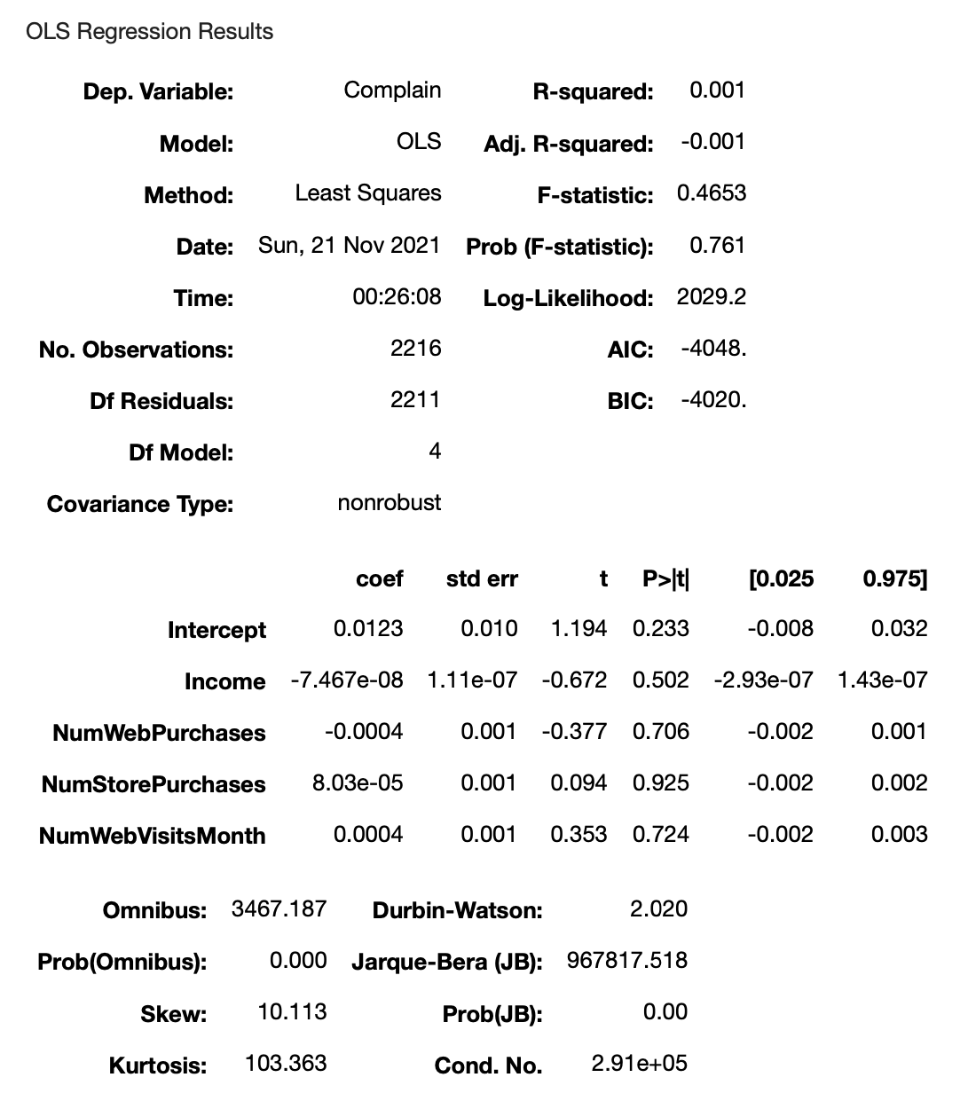
For this project, conduct a regression analysis on either one dependent and one explanatory variable, or multiple explanatory variables

Slide 15
Thank You!!

